Slide 1
_{Website Blocker and Unblocker}
As a Standalone Application
Team Members Name
1.Justus Kevin.T (111919104052)
2. Praveen.G (111919104098)
3. Ramanan.K (111919104108)

Slide 2
Abstract
Website Blocker/Unblocker is an application tool that denies and permits access to websites permanently to use the internet safely .
The local administrator can block all the website as they need via this application.
If required the local administrator can also unblock all those blocked websites through this same application

Slide 3
Introduction
UTLITY SOFTWARE:
Utility software helps manage, maintain ,control a computer
And support it’s infrastructure.
Every functionality of the computer uses a utility software.
Utility software is set of tools that helps configure, analyse and optimize computer resources to help users perform multiple tasks efficiently.
Most of the operating systems have input build-in utility tools, but additional software further ensure improved functionality.
Utility software focuses on computer components such a hardware, software operating system, network configuration and storage parts.
Example : data generators, hex editors, html checkers and merge programs

Slide 4
Existing System
The local administrator needs to manually enter to the website name with localhost ip address in the host file to block that particular website.
Also the local administrator can write a script for blocking the websites but requires to modify the script if new websites are needed to block.
The process to change the script will be tedious if the script is automated with os tasks

Slide 5
Disadvantages
Requires manual operation to add or remove website in host file
The script needs to be modified when new websites are added
Requires more effort if the script is automated with the os tasks
Once the script is automated websites cannot be unlocked /blocked at any time as per local administrator wishes.

Slide 6
Proposed System
Using this application project the local administrator just needs to enter the website name to block/unblock using gui(graphical user interface)
Once blocked/unblocked the application effect will be permanent in the system
Local administrator can use this application with ease as it provides with simple gui layout
The website will remain blocked eventhough VPN’s are used.
The local administrator does not need to setup a schedule task to block or unblock the website in the system

Slide 7
Advantages
Simple to use
Scheduled blocking is not required
Application effect will be permanent
Websites can be blocked/unblocked at any time as per local administrator thoughts

Slide 8
Literature Review
Base Paper Name | Author name / Published by | Published year | Abstract
Internet Society Perspectives on Internet Content Blocking : An Overview | Internet Society (ISOC) | 24 March 2017 | Understanding the different blocking techniques, their effects and side effects, is important both for policy makers considering the use of such measures and for Internet advocates and others wishing to influence content blocking practices. All blocking techniques are prone to two main drawbacks: They do not solve the problem They inflict collateral damage The Internet Society believes the most appropriate way to counteract illegal content and activities on the Internet is to attack them at their source. Using filters to block access to online content is inefficient, likely to be ineffective, and is prone to generate collateral damage affecting innocent Internet users. two main strategies to counteract the illegal content on the Internet: Attack the issue at the source Prioritize and use alternative approaches

Slide 9
Literature Review
Base Paper Name | Author name / Published by | Published year | Abstract
The Effectiveness of Internet Content Filters | Philip B Stark | January 2008 | As part of its defense of the Child Online Protection Act, which seeks to prevent minors from viewing commercially published harmful-to-minors material on the World Wide Web, the U.S. Department of Justice commissioned a study of the prevalence of “unwanted" materials and the effectiveness of Internet content filters in blocking them. As of 2005–2006, about 1.1% of webpages indexed by Google and MSN were unwanted—hundreds of millions of pages and about 6% of a set of 1.3 billion searches executed on AOL, MSN and Yahoo! in summer 2005 retrieved at least one unwanted webpage among the first ten results, and about 1.7% of those results are unwanted webpages. These estimates are based on both simple random samples of webpages indexed by search engines and on a stratified random sample of searches. Webpages intended with unwanted content were used to test a variety of Internet content filters for underblocking—failing to block webpages that they are intended to block. A random sample of "clean" webpages with no unwanted content or reference to unwanted content was used to test the filters for overblocking—blocking webpages they are not intended to block. Webpages retrieved by the most popular searches according to Wordtracker were also categorized and used to test filters. Generally, filters with lower rates of underblocking had higher rates of overblocking. If the filter most effective at blocking adult materials were applied to search indexes, typical query results, or the results of popular queries, the number of clean pages blocked in error would exceed the number of adult pages blocked correctly.

Slide 10
Literature Review
Base Paper Name | Author name / Published by | Published year | Abstract
Comparative Study on Blocking , Filtering and Take down of Illegal Internet Content | Swiss Institute of Comparative Law | 20 December 2015 | The study consists, essentially, of two main parts. The first part represents a compilation of country reports for each of the Council of Europe member states. It presents a more detailed analysis with to respect filtering, blocking and takedown of illegal content on the internet in each member state. For ease of reading and comparison, each country report follows a similar structure. The second part contains comparative considerations on the practices in the member states in respect of filtering, blocking and takedown of illegal online content. The purpose is to identify and to attempt to explain possible convergences and divergences between the member states’ approaches to the issues included in the scope of the study.

Slide 11
Literature Review
Base Paper Name | Author name/ Published by | Published year | Abstract
RFC 7754-Technical Consideration for Internet service Blocking and Filtering | 1.Richard barnes 2.Alissa cooper 3.Olaf kolkman 4.Dave thaler 5.Erik nordmark | March 2016 | The Internet is structured to be an open communications medium. This openness is one of the key underpinnings of Internet innovation, but it can also allow communications that may be viewed as undesirable by certain parties. Thus, as the Internet has grown, so have mechanisms to limit the extent and impact of abusive or objectionable communications. There has been an increasing emphasis on "blocking" and "filtering", the active prevention of such communications. Several technical approaches to Internet blocking and filtering in terms of their alignment with the overall Internet architecture is examined . When it is possible to do so, the approach to blocking and filtering that is most coherent with the Internet architecture is to inform endpoints about potentially undesirable services, so that the communicants can avoid engaging in abusive or objectionable communications. It is observed that certain filtering and blocking approaches can cause unintended consequences to third parties.

Slide 12
Literature Review
Base Paper Name | Author name/ Published by | Published year | Abstract
Internet Content Filtering Guideline – Department of Education and Training (Title : Guidelines for Managing Access to the Content on the Internet) | Victoria State Government | 22 October 2018 | It outlines the guidelines for managing access to internet content by all users on the Department's corporate network. Access to internet content is controlled using an internet filtering service It provides outlines for managing the categories of content that are allowed and blocked by the internet filtering service. It also provides outlines for managing exceptions. The internet filtering service uses categories to allow or block access to websites or web pages on internet sites. The filtering service uses the content of information on the internet site to determine the category for the site. The filtering service will allow access to a site whose category is allowed, and block access to a site in a category that is blocked. Access to sites may also be blocked on advice of the government and non-government security specialists to protect the information assets of the Department. Blocking access to internet sites to protect Department information assets will be managed by ICT security specialists in the Department.

Slide 13
Modules
Website_blocker.py:
This module is used to run the website blocker application to block the websites as the local administrator wishes.
This module is responsible for finding the hostfile path for the OS used in the system , building a simple GUI window for application and writing the website name to the hostfile.
Sub modules used in website_blocker.py:
1. hostfilePath
2. runapp
3. Blocker

Slide 14
Modules
Website_unblocker.py:
This module is used to run the website unblocker application to unblock the websites as the local administrator wishes.
This module is responsible for finding the hostfile path for the OS used in the system , building a simple GUI window for application and removing the website name to the hostfile.
Sub modules used in website_unblocker.py:
1. hostfilePath
2. runapp
3. Unblocker

Slide 15
Modules
HostfilePath:
This module returns the absolute path location of host file in the currently working system.
First it finds the OS of the working system using in-built python module ‘ platform ’ and based on the OS , host file path is returned to the application
If the OS of the working system is Windows then it returns the host file path as C:\windows \system32\drivers\etc\hosts to run
If the OS of the working system is Linux (or) Mac then it returns the host file path as /etc/hosts
If the OS of the working system is not identified then it displays ‘ Operating system cannot be recognized in this system ’ .

Slide 16
Modules
Runapp:
This module builds up the GUI for the website_blocker.py module and website_unblocker.py module.
After retrieving the absolute path of host file , the runapp module starts to build a simple GUI window using the python in-built module ‘tkinter’ .
The GUI window contains tkinter elements like textarea , window titlename , label and a button .
This GUI window also displays messagebox using the in-built python module ‘tkinter.messagebox’ to display the website is already blocked/unblocked (or) website is blocked/unblocked successfully.

Slide 17
Modules
Blocker:
This module gets the website to be blocked from the user by matching the host website ip address to local host ip address
After the host website ip address is matched to local host ip address it is written to the host file of the respective OS used
The absolute path of host file is retrieved from the module ‘ hostfilePath ‘ .

Slide 18
Modules
Unblocker:
This module gets the website to be unblocked from the user by matching the website name needed to be unblocked to the websites present in the host file.
After the website name is matched to host file websites it is removed from the host file of the respective OS used
The absolute path of host file is retrieved from the module ‘ hostfilePath ‘ .

Slide 19
Algorithm (URL Based Blocking)
Algorithm for website blocker application:
Local administrator enters multiple websites to block
Then clicking on the block button it will check the condition that if the website is already blocked
If already blocked then it displays ‘already blocked’
Else if blocks all the mentioned websites and displays ‘blocked’
Algorithm for website unblocker application:
Local administrator enters one website at a time to unblock
Then clicking on the unblock button will check the condition that if the website is already unblocked
If already unblocked then it displays ‘already unblocked’
Else if unblocks the mentioned website and displays ‘unblocked’

Slide 20
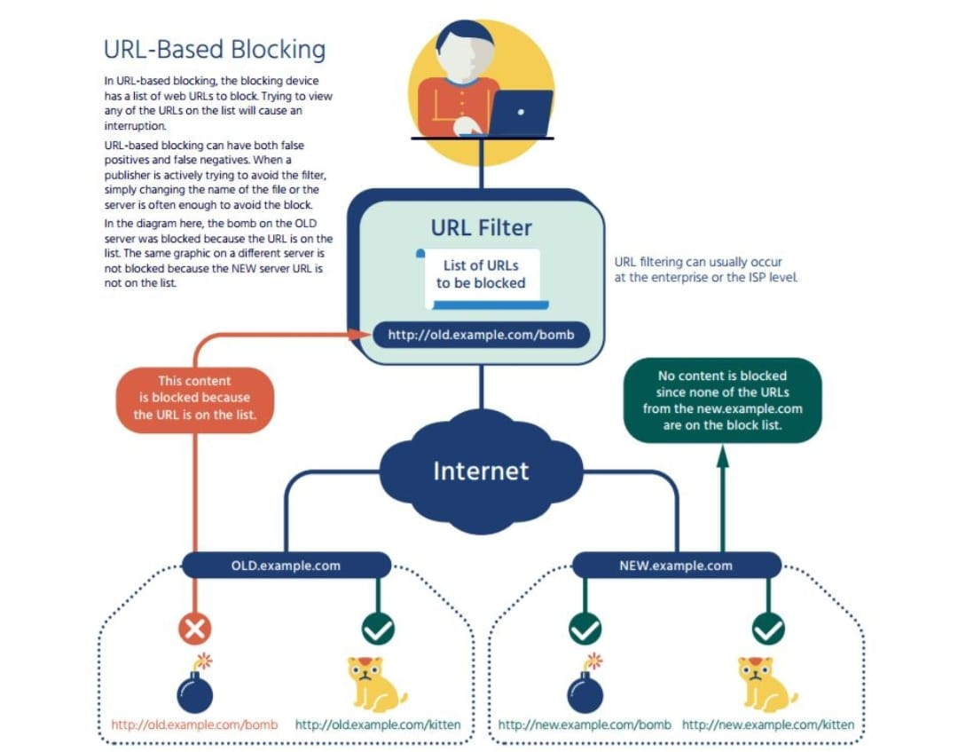
Architecture Diagram of Project

Slide 21
Methodology
1.Host file:
Every system has host file whether it is mac, windows or linux.
Host file location in mac and linux :
/etc/hosts
Host file location in windows:
C:\windows \system32\drivers\etc\hosts
2.Working of host file:
Host is an operating system file which maps hostnames of websites to our localhost address .
Using python file handling manipulation the hostname will be written in or removed from hosts.txt of the respective os
After the host file is saved the mentioned websites in the file will be blocked and the websites that aren’t in the file remains unblocked.

Slide 22
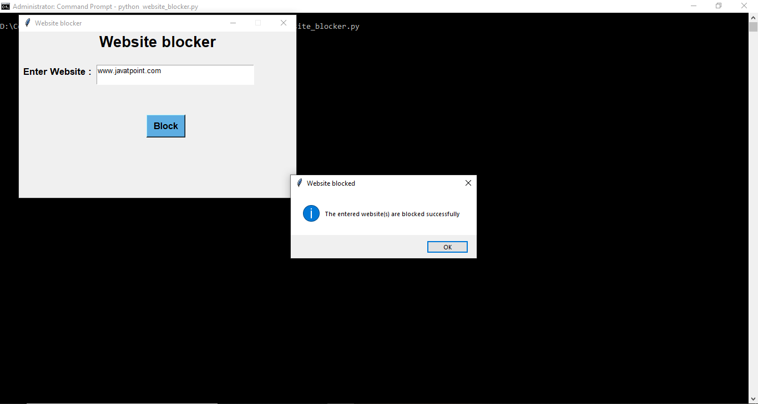
Result for Blocker

Slide 23

Result for Blocker

Slide 24
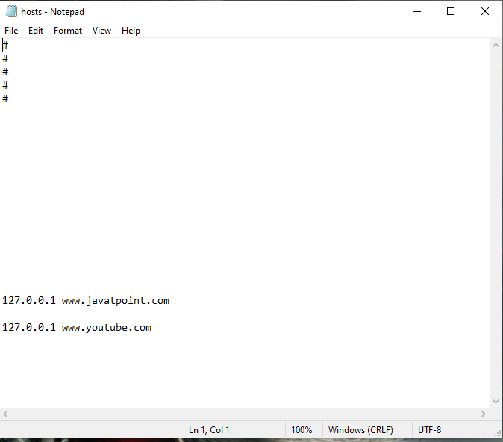
Result for Blocker

Slide 25
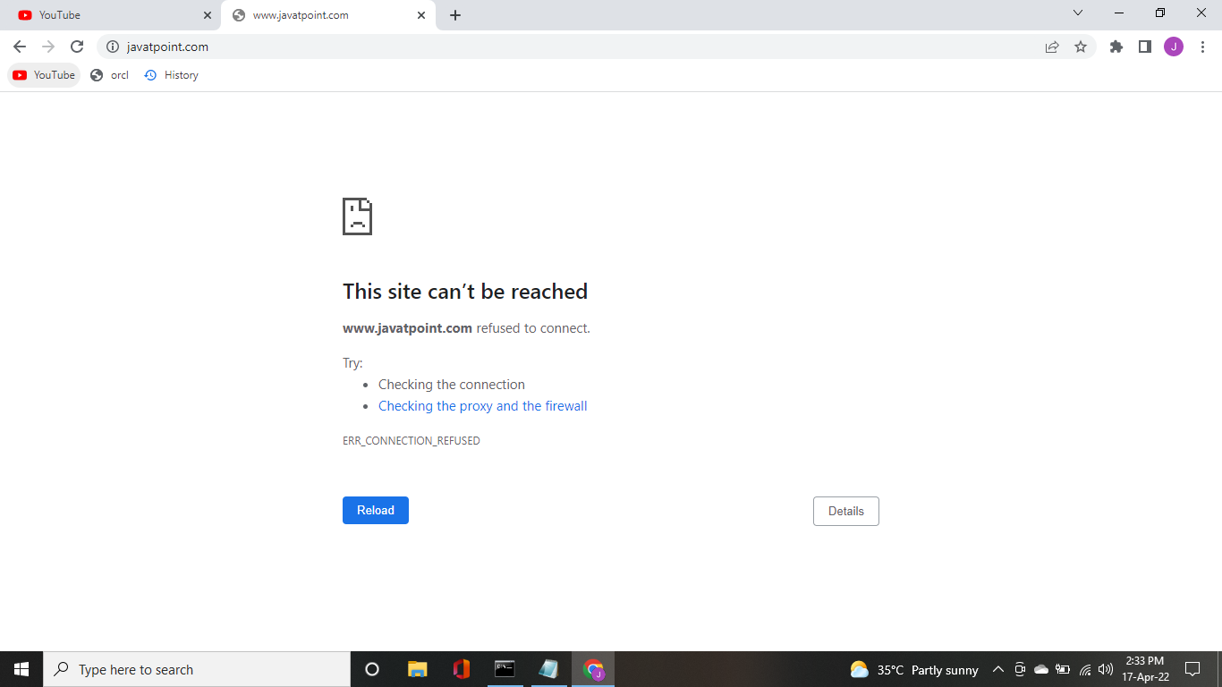
Result for Blocker

Slide 26
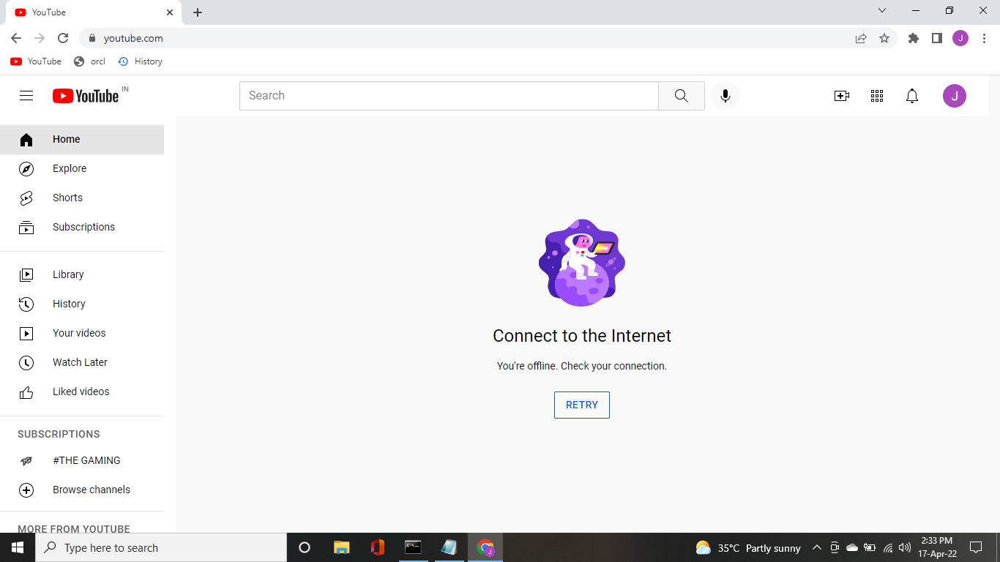
Result for Blocker

Slide 27
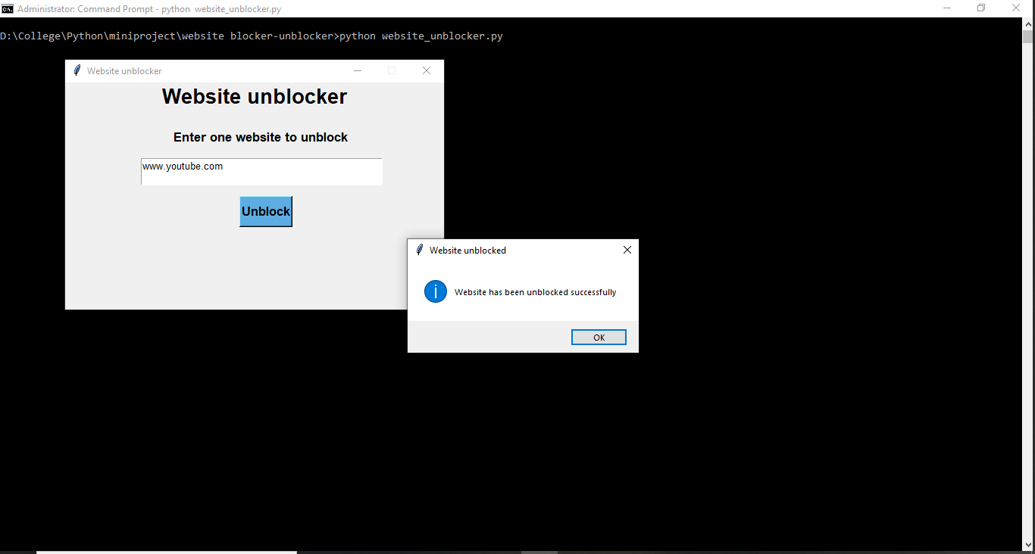
Result for Unblocker

Slide 28
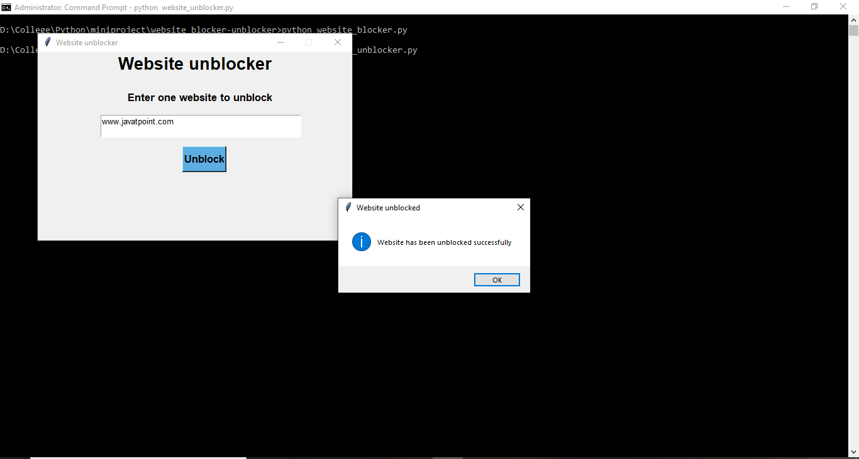
Result for Unblocker

Slide 29
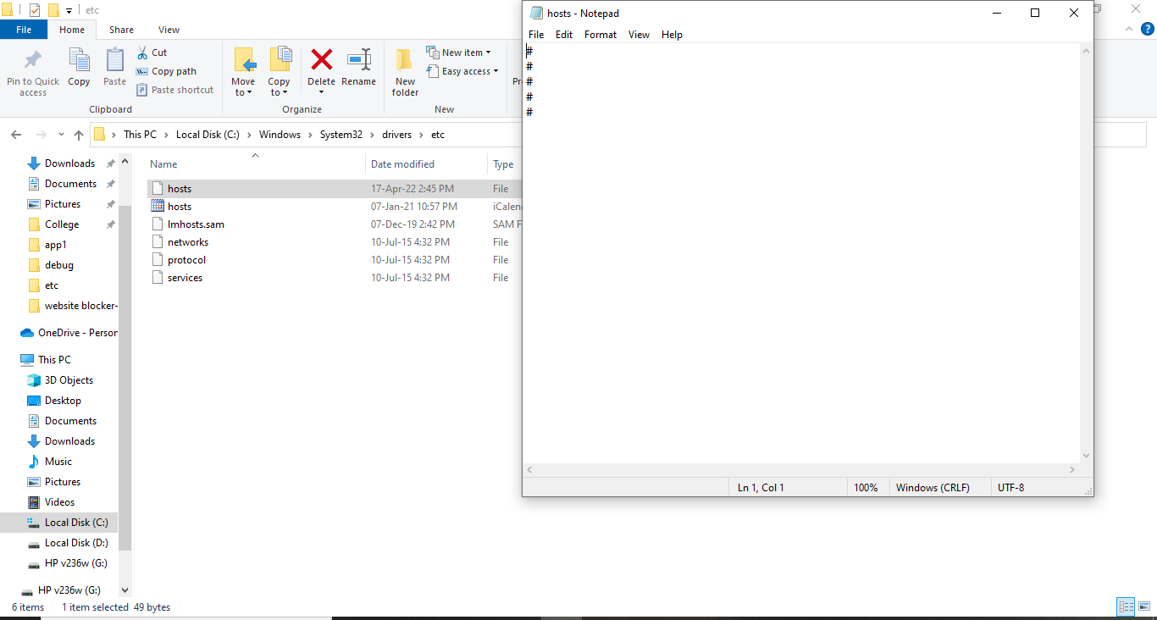
Result for Unblocker

Slide 30
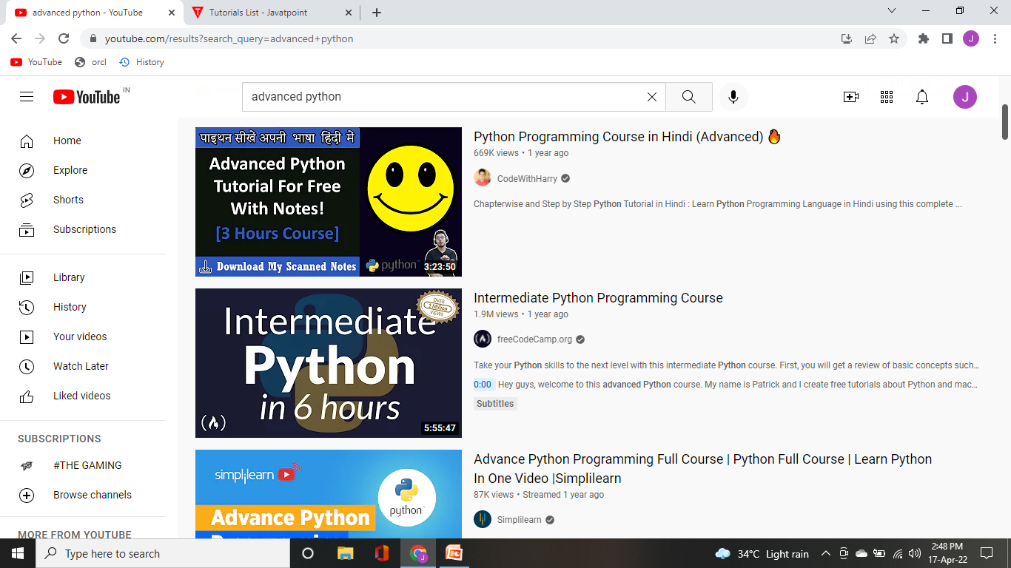
Result for Unblocker

Slide 31
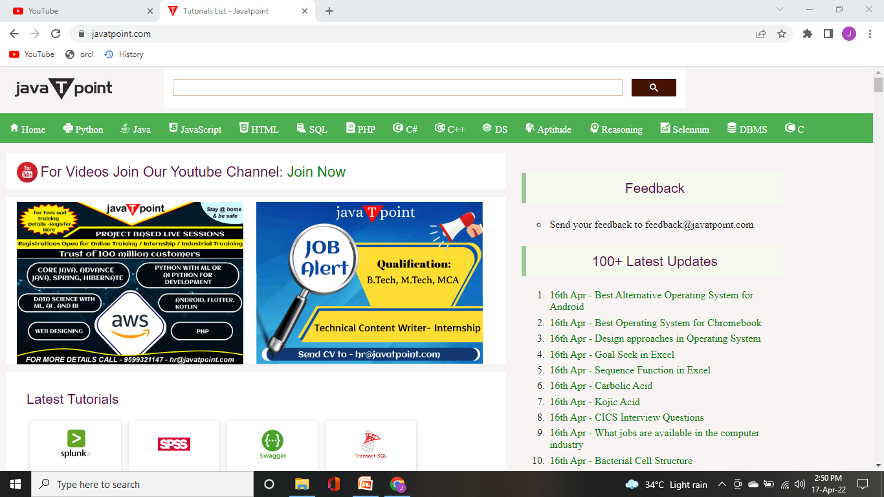
Result for Unblocker

Slide 32
Conclusion
This project helps to block and unblock n websites in the system that uses windows/linux/mac os.
The local users cannot access the websites that are blocked by the local administrator of the respective system.
The administrator can block and unblock at his/her own will that doesn’t require scheduling.
Misleading and distractive websites that reduce the productivity of the users can blocked during working hours.

Slide 33
Reference
1. Internet Society Perspectives on Internet Content Blocking : An Overview
- ISOC (Internet Society), 24 March 2017
2. Internet Content Filtering Guideline – Department of Education and Training (Title : Guidelines for Managing Access to the Content on the Internet), Victoria State Government , 22 October 2018
3. The Effectiveness of Internet Content Filters, Philip B.stark , January 2008
4. RFC 7754 – Technical Consideration for Internet Service Blocking and
Filtering , Richard barnes , Alissa cooper , Olaf kolkman , Dave thaler and Erik
nordmark , March 2016
5. Comparative study on Blocking ,Filtering and Take down of Illegal Internet Content , Swiss Institute of Comparative Law , 20 December 2015

Slide 34
THANK YOU

